Slide 1

American International University-Bangladesh.
Faculty of Engineering (EEE)
Course: Digital Logic and Circuits Lab
Supervisor: BISMOY JAHAN
Project: Counting Factory Products Using Counter Circuit
Group: 7
SL | NAME | ID | PROGRAM
1 | Abul Bashar Saurov | 22-48823-3 | CSE
2 | Kamrul Hasan Tonmoy | 22-48825-3 | CSE
3 | Md Sakib Hossan Samad | 22-49359-3 | CSE
4 | Al- Amin | 22-47731-2 | CSE
5 | Md. Sajib Mondol | 22-48824-3 | CSE

Slide 2
Objectives:
To design a system that counts factory products using an IR proximity sensor and displays the count on a 7-segment display.

Slide 3
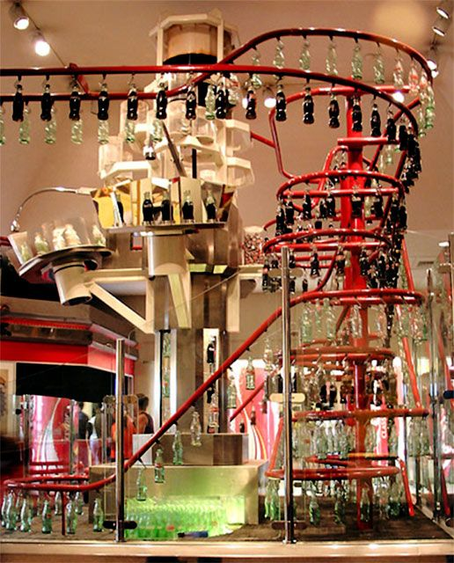

Purpose of our Project
Simple and Efficient
Cost effective
To Use Real-time Data

Slide 4
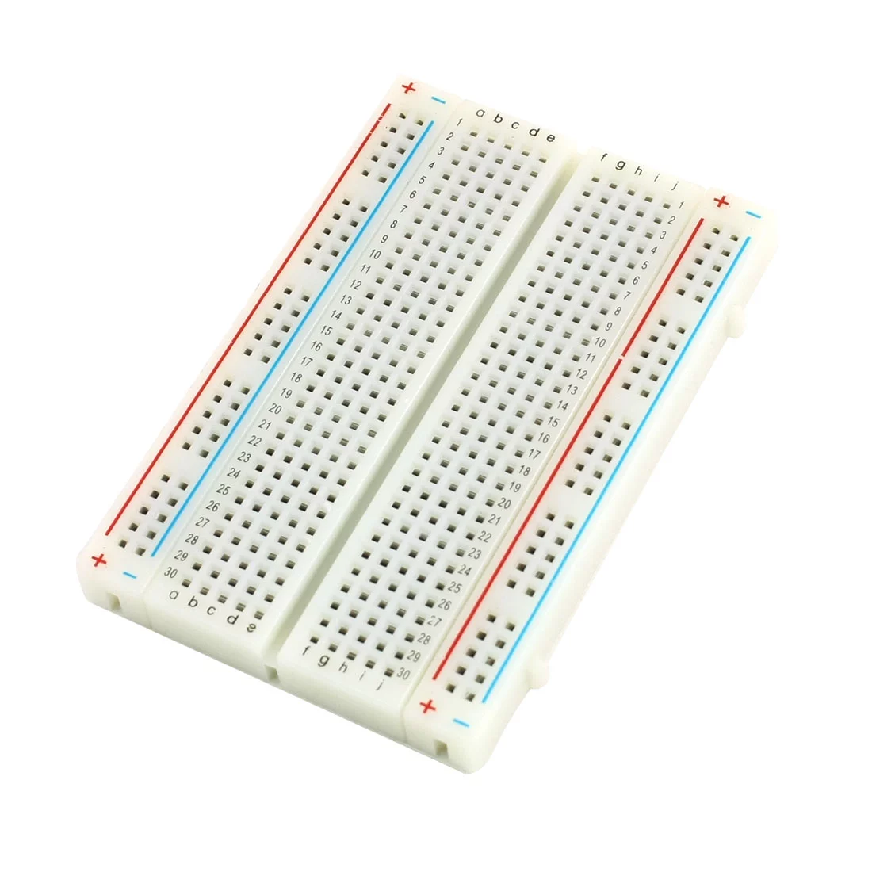
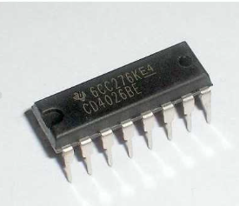
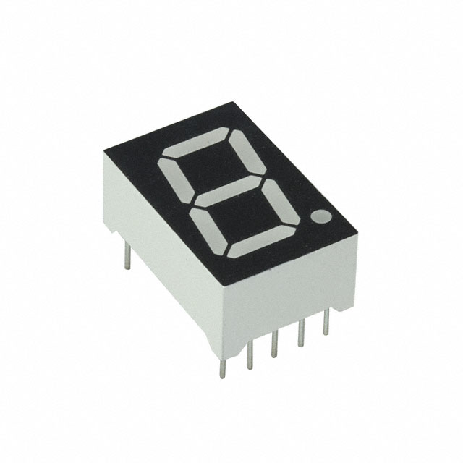
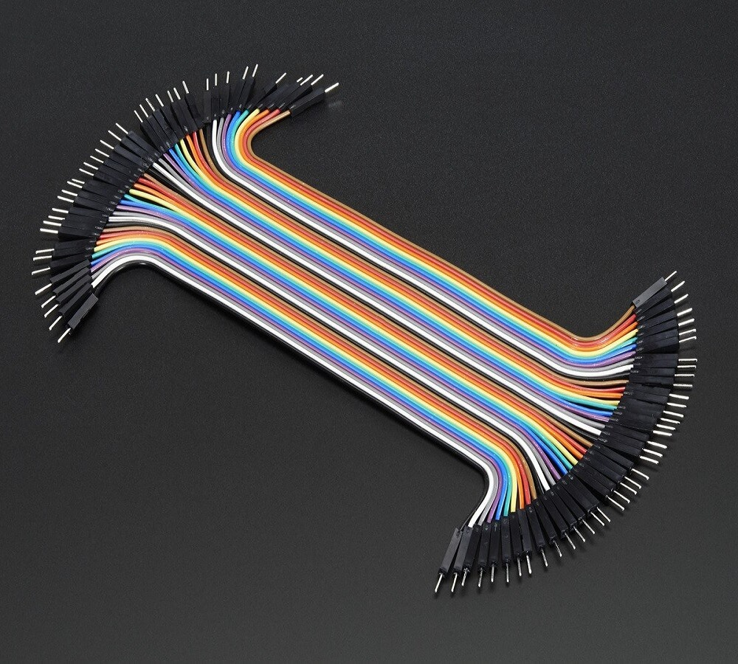
Component & Description
1. IC 4026
3. Bread Board
2. 7 Segment Display
4. Jumper Wire

Slide 5
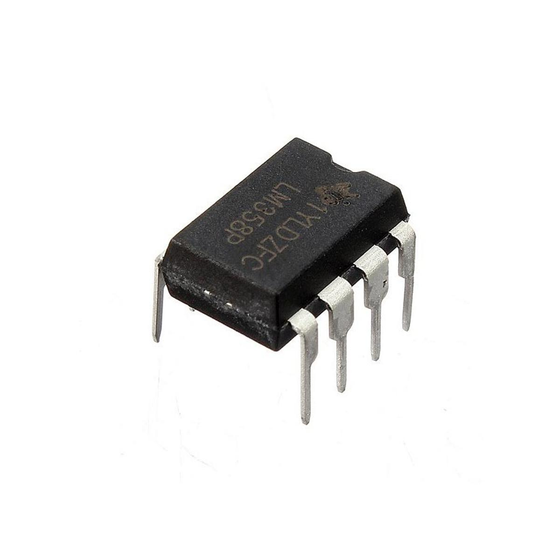
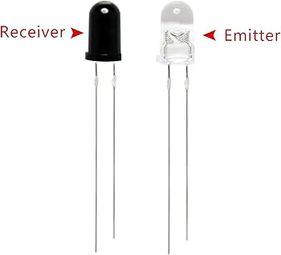
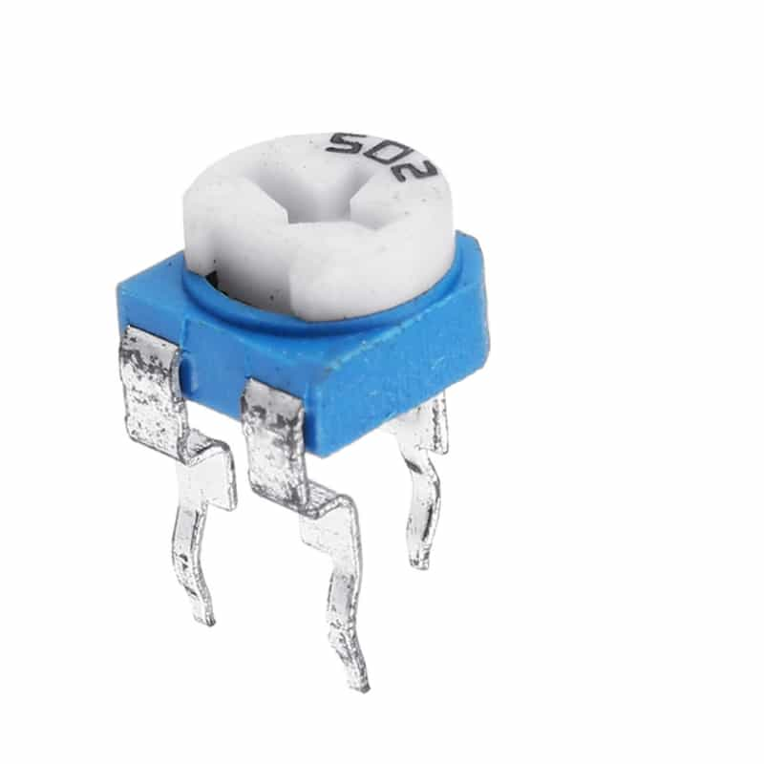
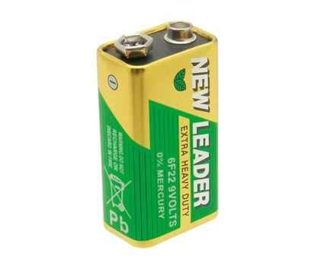
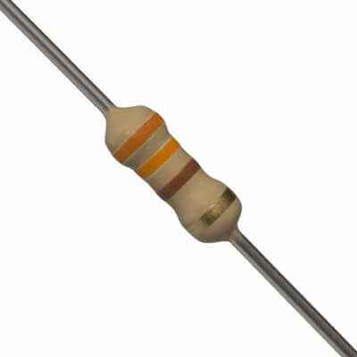
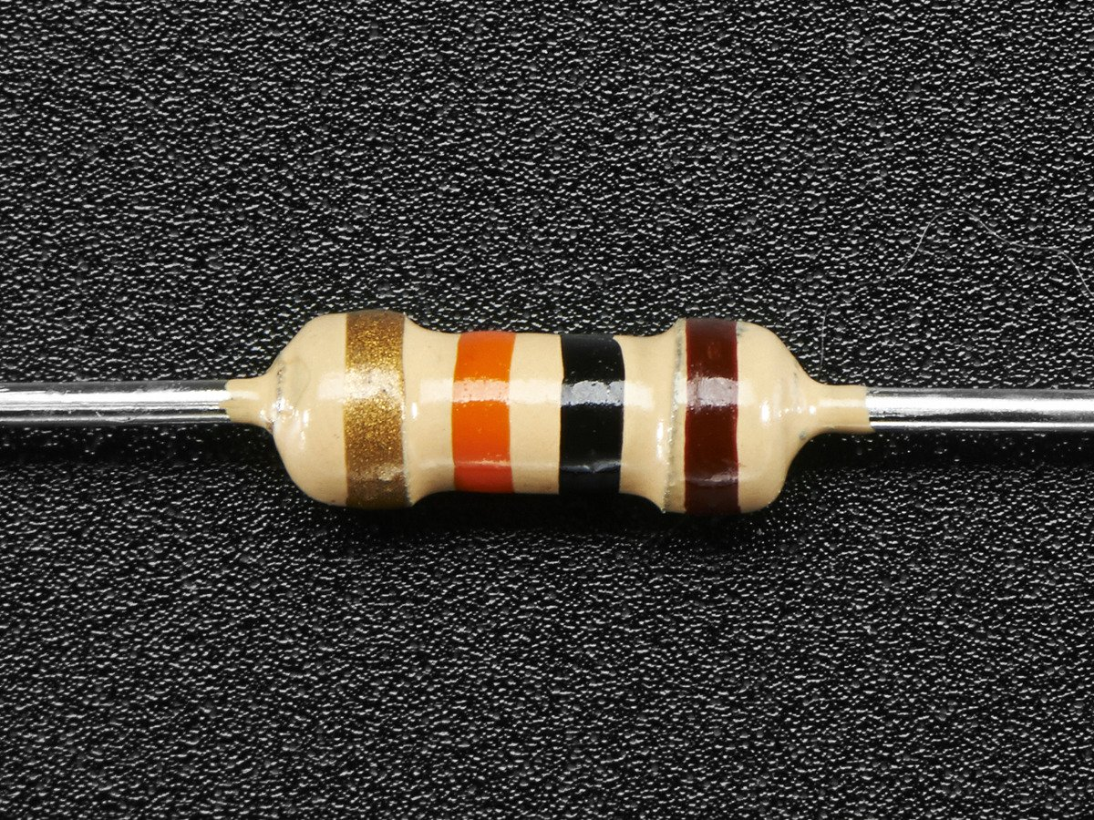
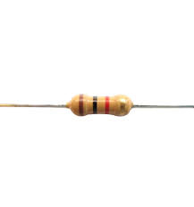
Component & Description (Continued)
6. IC LM358
7. 10K Potentiometer
5. IR LED &IR Receiver
8. 9V battery
9. Resistors: 330 ohm, 10K ohm & 1K ohm

Slide 6
Working Principles:
When an object is detected by the IR sensor, the IR receiver sends a signal to the circuit, which triggers the 4026 IC to update the count displayed on the 7-segment display.
Whenever a object take entry the display number increases.

Slide 7
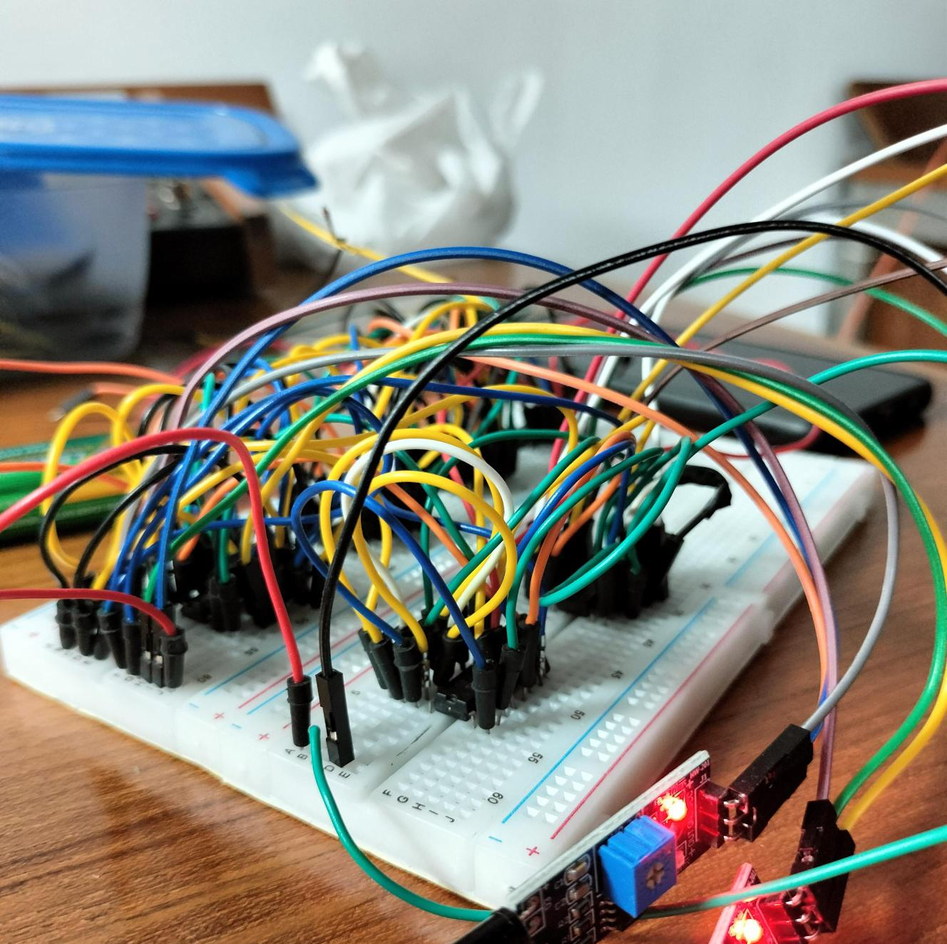
Description of Our work:
Developed an IR Proximity Sensor-Based Counter Circuit to count objects passing in front of a sensor.
Designed a schematic diagram illustrating connections between the IR sensor, LM358 IC, 4026 IC, and a 7-segment display.
Assembled the circuit on a breadboard, ensuring proper connections and functionality.
Tested the system rigorously, fine-tuning the potentiometer for optimal sensitivity and performance.
Focused on precision and adaptability to create a cost-effective solution for counting objects in industrial applications.

Slide 8
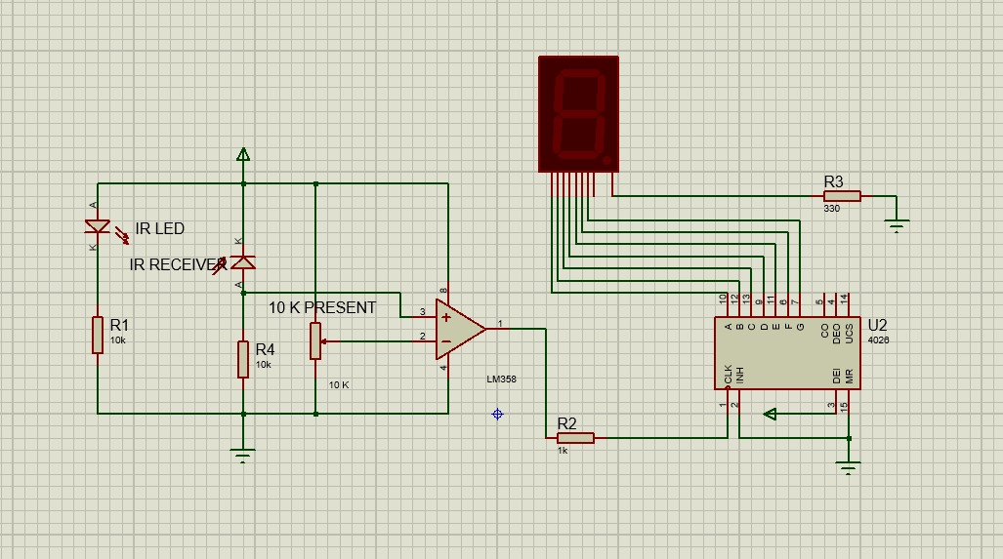
Circuit Diagram

Slide 9
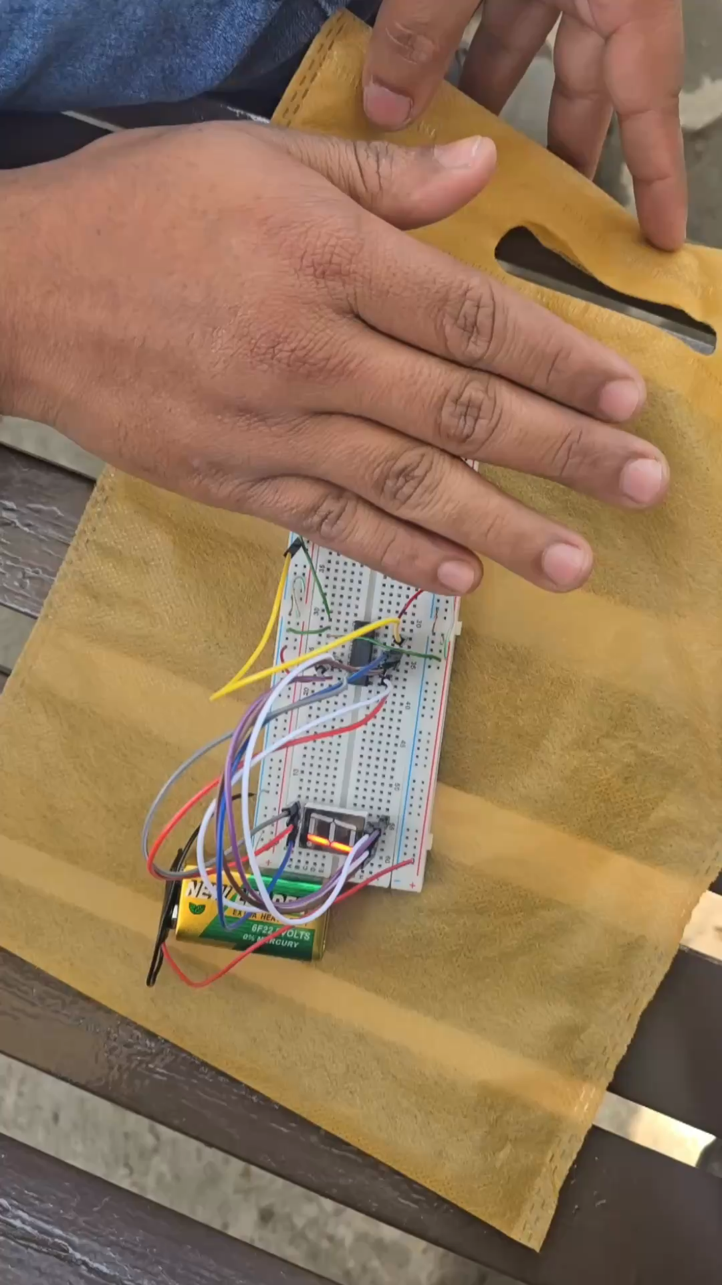
Working Process

Slide 10
Result:
Future Steps for Improvement: Suggestions include enhancing the detection range, integrating a multi-digit display for higher counts, and automating the system for real-world deployment.
Troubleshooting Actions Taken: The potentiometer was fine-tuned, and signal paths were verified to optimize sensor performance.
Technical Challenges Encountered: Minor sensitivity adjustments were required to ensure reliable detection of objects of varying sizes.
System Performance: The circuit functioned as intended, demonstrating accurate object detection and counting in a simulated environment.
Project Outcome: The IR proximity sensor-based counter circuit successfully detected objects and updated the count on the 7-segment display.

Slide 11
Conclusion:
Efficient counting mechanism for factory products.
Cost-effective and reliable for industrial use.
Future Scope: Integrate with IoT for remote monitoring.
Future Scope: Expand to multi-digit displays for large counts.

Slide 12
References:
1. https://www.pantechsolutions.net/arm-7-digital-counter-using-proximity-sensor
2.https://forum.allaboutcircuits.com/threads/circuit-of-counter-by-ir-and-display-on-7-segment-without-programming.56254/
3. https://www.hackster.io/vasoyasujal42/object-counter-with-ir-sensor-3f7265

